Slide 1

ECE 1710: Power Distribution Engineering and Smart Grids
Lecture 14
Dr. Robert Kerestes
University of Pittsburgh
Swanson School of Engineering
Department of Electrical and Computer Engineering
Notes:
Instructions for editing school and department titles:
Select from menu: View > Master > Slide Master
Click on each text area you wish to edit. Text will become editable.

Slide 2
Outline
Outline of Lecture No. 16
Module #1: Introduction to three-phase step-voltage regulators
Module #2: Wye-Connected Regulators
Module #3: Closed Delta – Connected Regulators
Module #4: Open Delta – Connected Regulators

Slide 3
Learning Objectives
Learning Objectives:
Describe the components and settings of the step-voltage regulator control circuit
State the difference between Type A and Type B voltage regulators and identify them by their equivalent and abbreviated circuits
Apply the voltage and current equations for the Type B voltage regulator
Calculate the a, b, c, d, A and B for the Type B voltage regulator and use them to solve for system voltages and currents
Determine PT & CT ratings and R & X settings for load drop compensator circuits and calculate equivalent line impedances

Slide 4
Introduction to Three-Phase Step-Regulators
Module #1

Slide 5
Introduction to Three-Phase Step-Up Regulators
Module #1
Three single-phase step-voltage regulators can be connected externally to form a three-phase regulator.
When three single-phase regulators are connected together, each regulator has its own compensator circuit, and, therefore, the taps on each regulator are changed separately.

Slide 6
Introduction to Three-Phase Step-Up Regulators
Module #1
Typical connections for single-phase step-regulators are
Single phase
Two regulators connected in “open wye” (sometimes referred to as “V” phase)
Three regulators connected in grounded wye
Two regulators connected in open delta
Three regulators connected in closed delta

Slide 7
Introduction to Three-Phase Step-Up Regulators
Module #1
A three-phase regulator has the connections between the single-phase windings internal to the regulator housing.

Slide 8
Introduction to Three-Phase Step-Up Regulators
Module #1
The three-phase regulator is “gang” operated so that the taps on all windings change the same, and, as a result, only one compensator circuit is required.
For this case, it is up to the engineer to determine which phase current and voltage will be sampled by the compensator circuit.
Three-phase regulators will only be connected in a three-phase wye or closed delta.
Many times the substation transformer will have LTC windings on the secondary. The LTC will be controlled in the same way as a gang-operated three-phase regulator.

Slide 9
Introduction to Three-Phase Step-Up Regulators
Module #1
In the regulator models we will develop, the phasing on the source (high) side of the regulator will use capital letters A, B, and C. The load (low) side phasing will use lower case letters a, b, and c.

Slide 10
Module #2
Wye-Connected Regulators

Slide 11
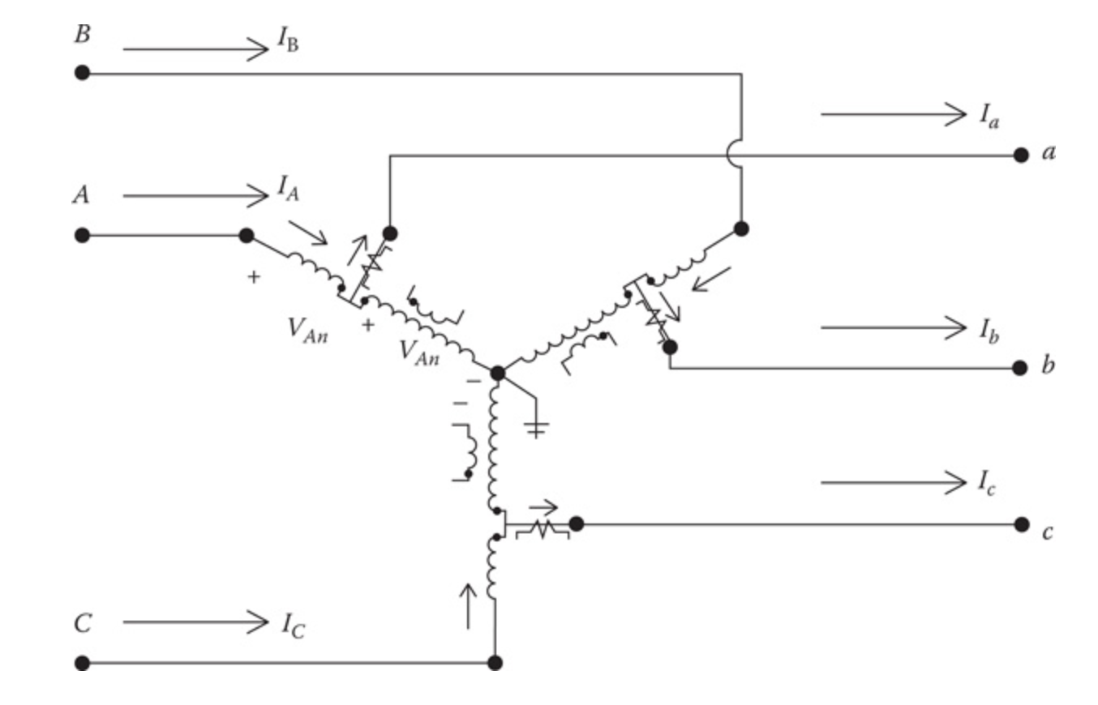
Wye-Connected Regulators
Module #2
Three Type B single-phase regulators connected in wye are shown in below

Slide 12
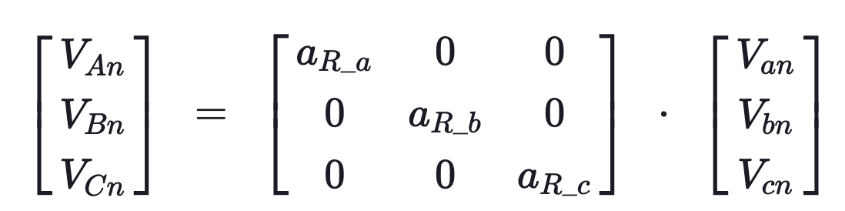
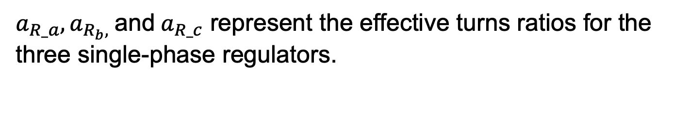
Wye-Connected Regulators
Module #2
The voltage equation is (neglecting regulator impedance)
$a_{R_a},a_{R_{b},} \text{and} a_{R_c}$ represent the effective turns ratios for the three single-phase regulators.

Slide 13
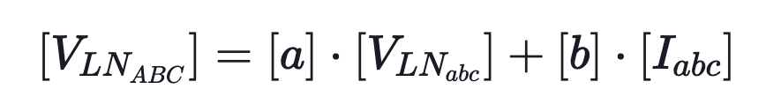
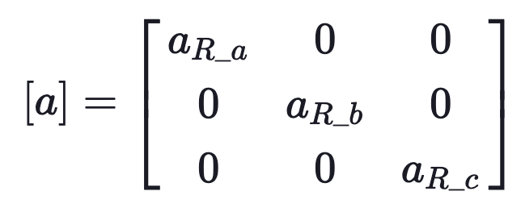
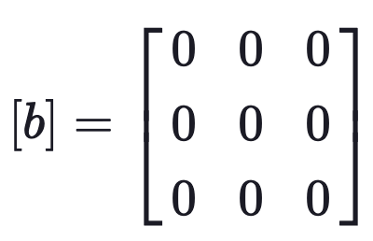
Wye-Connected Regulators
Module #2
This gives us
where

Slide 14
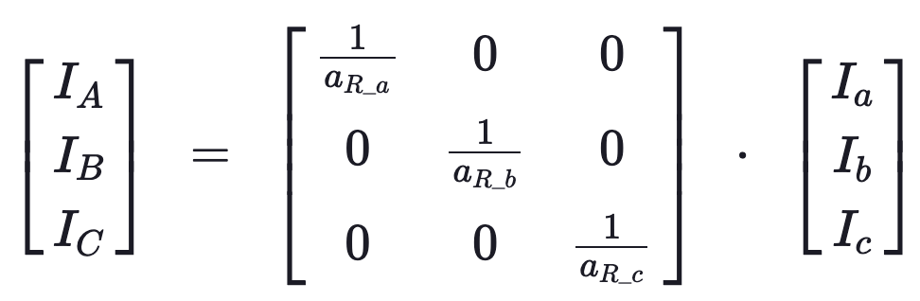
Wye-Connected Regulators
Module #2
The current equation is (neglecting regulator shunt admittance)

Slide 15
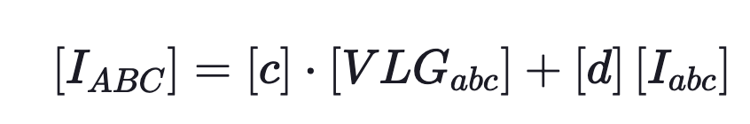
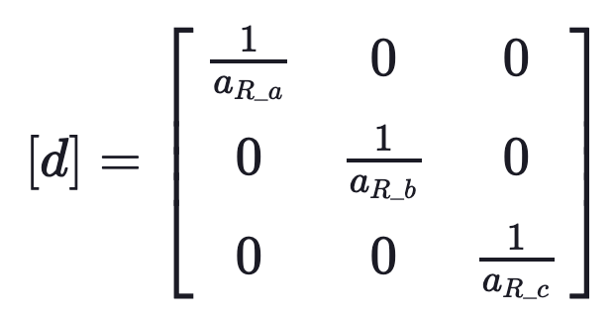
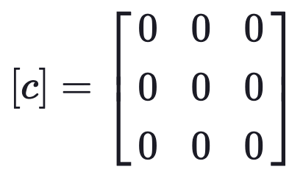
Wye-Connected Regulators
Module #2
This gives us
where

Slide 16
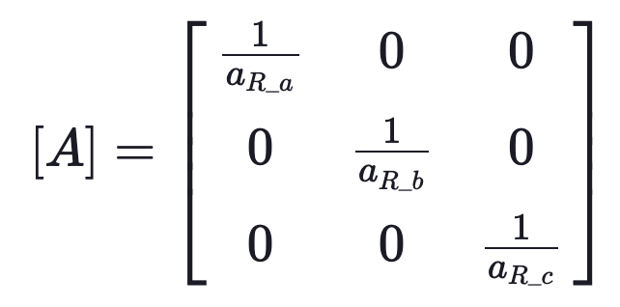
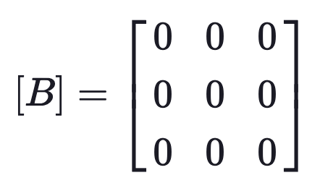
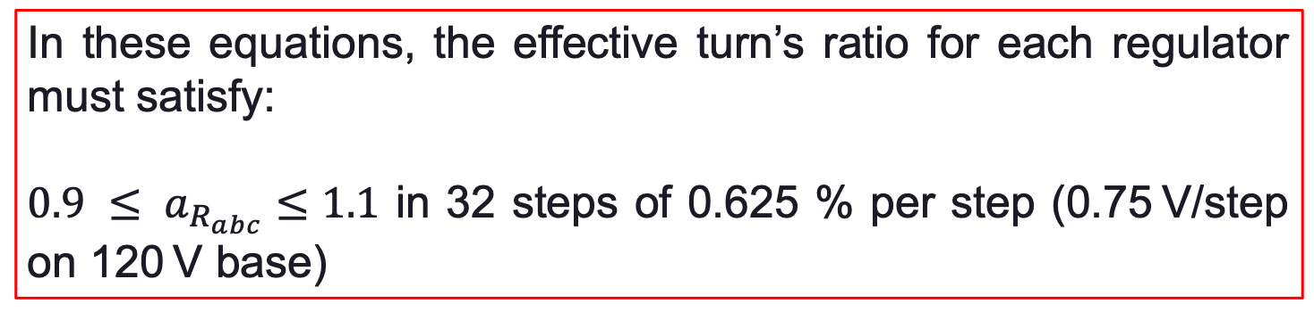
Wye-Connected Regulators
Module #2
Lastly,
In these equations, the effective turn’s ratio for each regulator must satisfy:
$0.9 ≤ a_{R_{abc}}≤1.1$ in 32 steps of 0.625 % per step (0.75 V/step on 120 V base)

Slide 17
Module #3
Closed Delta-Connected Regulators

Slide 18
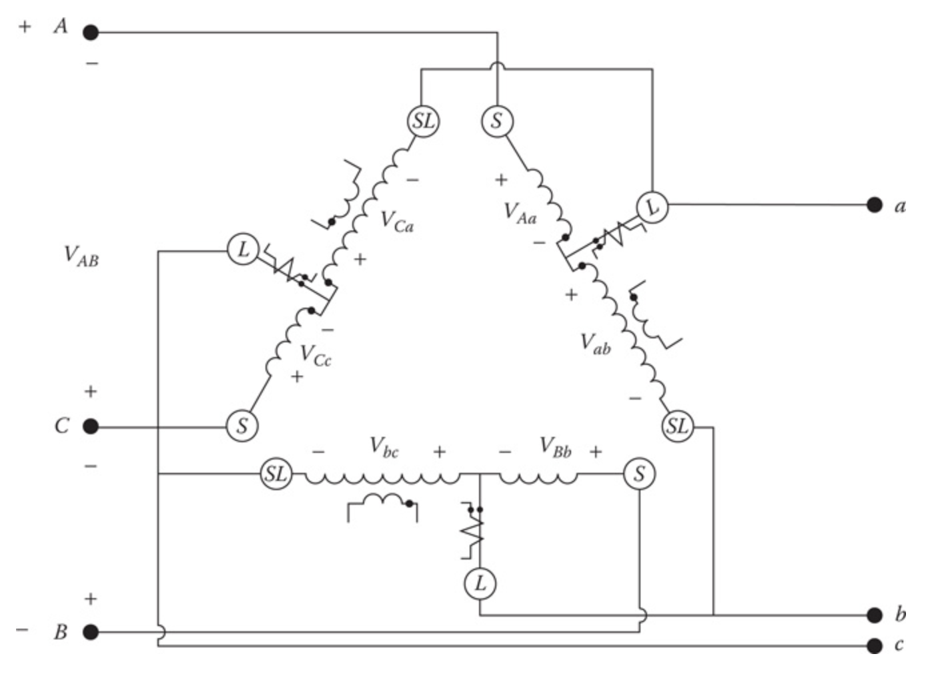
Closed Delta-Connected Regulators
Module #3
Three Type B single-phase regulators connected in closed delta are shown in below

Slide 19
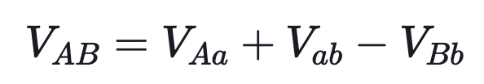
Closed Delta-Connected Regulators
Module #3
Kirchhoff’s Voltage Law is first applied around a closed loop starting with the line-to-line voltage between phases A and B on the source side.

Slide 20
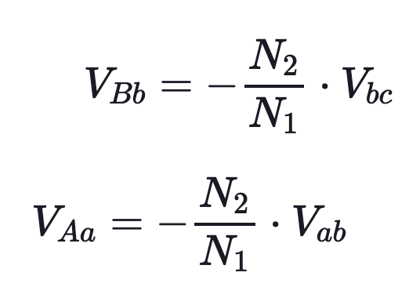
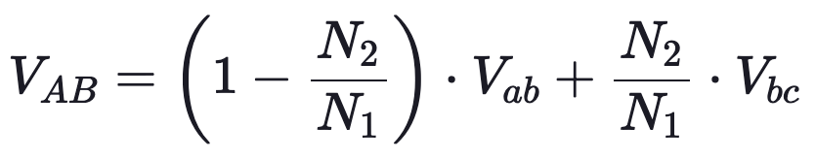
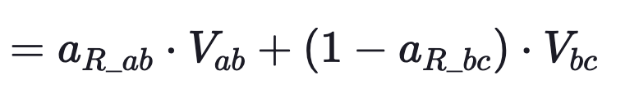
Closed Delta-Connected Regulators
Module #3
But
Substituting

Slide 21
Closed Delta-Connected Regulators
Module #3
But
Substituting

Slide 22
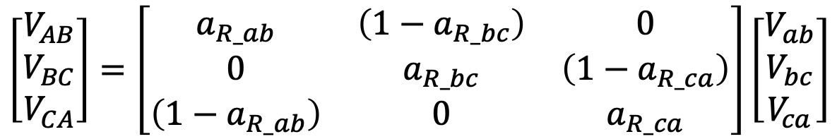
Closed Delta-Connected Regulators
Module #3
We can repeat for phase B and phase C
$$V_{BC}=a_{R_bc}∙V_{bc}+\left(1−a_{R_ca}\right)∙V_{ca}$$
$$V_{CA}=a_{R_ca}∙V_{ca}+\left(1−a_{R_ab}\right)∙V_{ab}$$
Which gives us
$$\left[\begin{matrix}V_{AB} \\ V_{BC} \\ V_{CA}\end{matrix}\right]=\left[\begin{matrix}a_{R_ab} & \left(1−a_{R_bc}\right) & 0 \\ 0 & a_{R_bc} & \left(1−a_{R_ca}\right) \\ \left(1−a_{R_ab}\right) & 0 & a_{R_ca}\end{matrix}\right]\left[\begin{matrix}V_{ab} \\ V_{bc} \\ V_{ca}\end{matrix}\right]$$

Slide 23
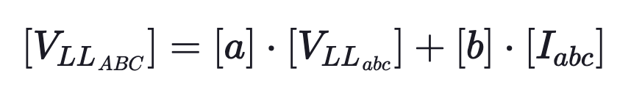
Closed Delta-Connected Regulators
Module #3
Which is of the form
with [b] being the zero matrix

Slide 24
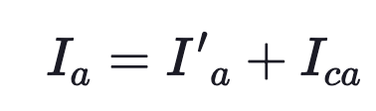
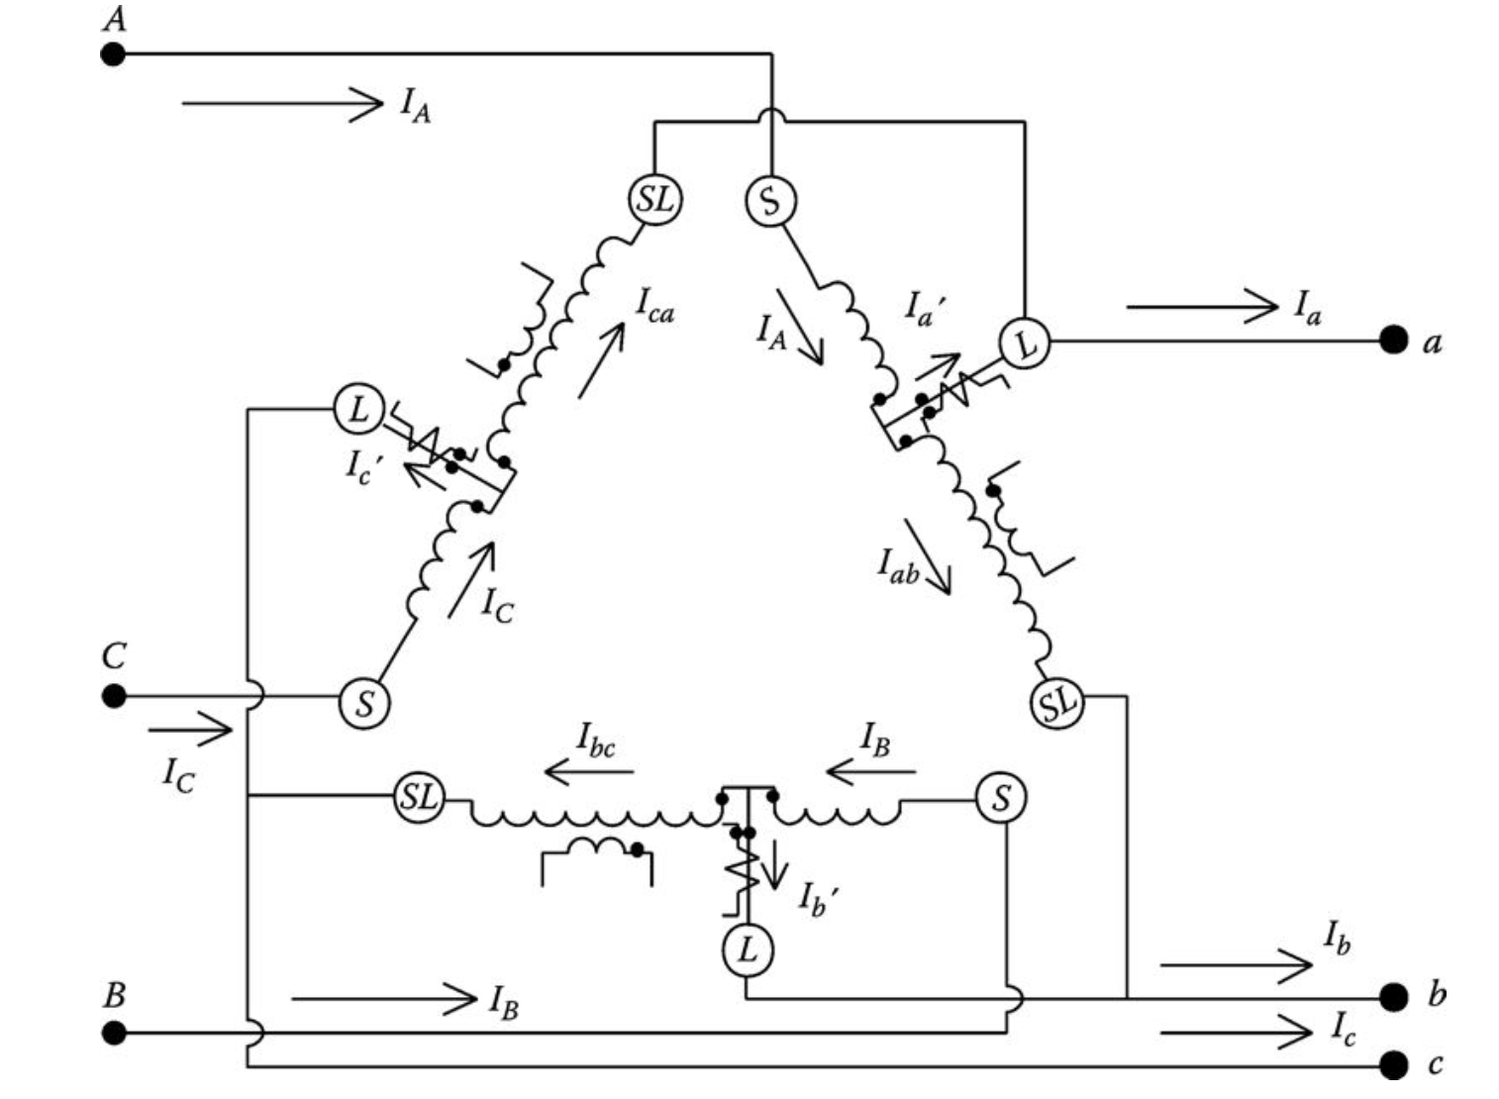
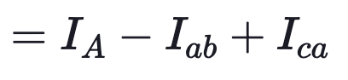
Closed Delta-Connected Regulators
Module #3
Similarly the relationship between source and load line currents starts with applying KCL at the load-side terminal a.

Slide 25
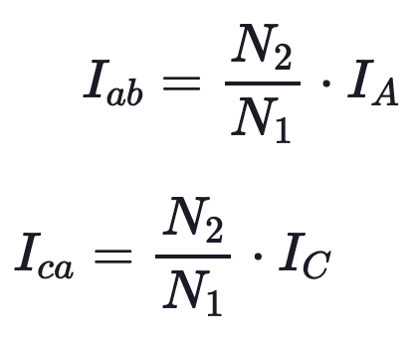
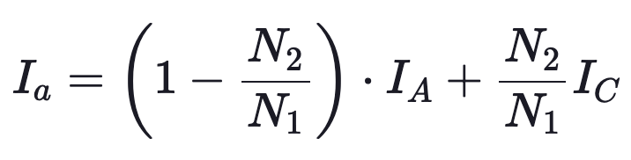
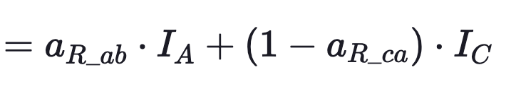
Closed Delta-Connected Regulators
Module #3
But
Substituting

Slide 26
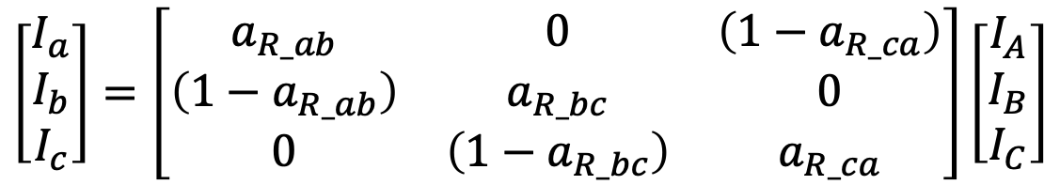
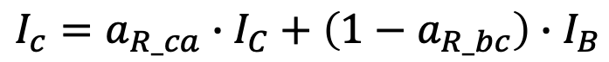
Closed Delta-Connected Regulators
Module #3
We can repeat for phase B and phase C
$$I_{b}=a_{R_bc}∙I_{B}+\left(1−a_{R_ab}\right)∙I_{A}$$
$$I_{c}=a_{R_ca}∙I_{C}+\left(1−a_{R_bc}\right)∙I_{B}$$
Which gives us
$$\left[\begin{matrix}I_{a} \\ I_{b} \\ I_{c}\end{matrix}\right]=\left[\begin{matrix}a_{R_ab} & 0 & \left(1−a_{R_ca}\right) \\ \left(1−a_{R_ab}\right) & a_{R_bc} & 0 \\ 0 & \left(1−a_{R_bc}\right) & a_{R_ca}\end{matrix}\right]\left[\begin{matrix}I_{A} \\ I_{B} \\ I_{C}\end{matrix}\right]$$

Slide 27
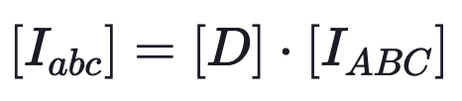
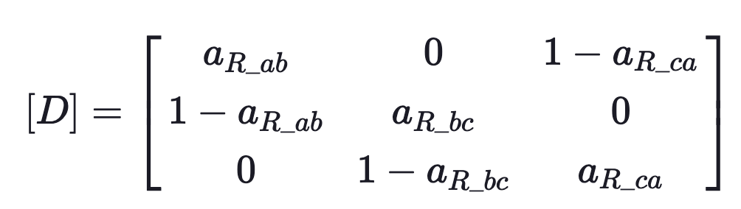
Closed Delta-Connected Regulators
Module #3
This gives us
where

Slide 28
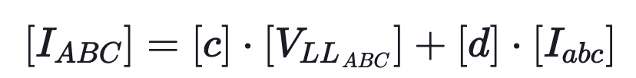
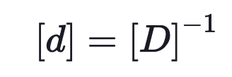
Closed Delta-Connected Regulators
Module #3
So the general form
can be obtained by
with [c] equal to the zero matrix

Slide 29
Closed Delta-Connected Regulators
Module #3
So the general form
can be obtained by
with [c] equal to the zero matrix

Slide 30
Module #4
Open Delta-Connected Regulators

Slide 31
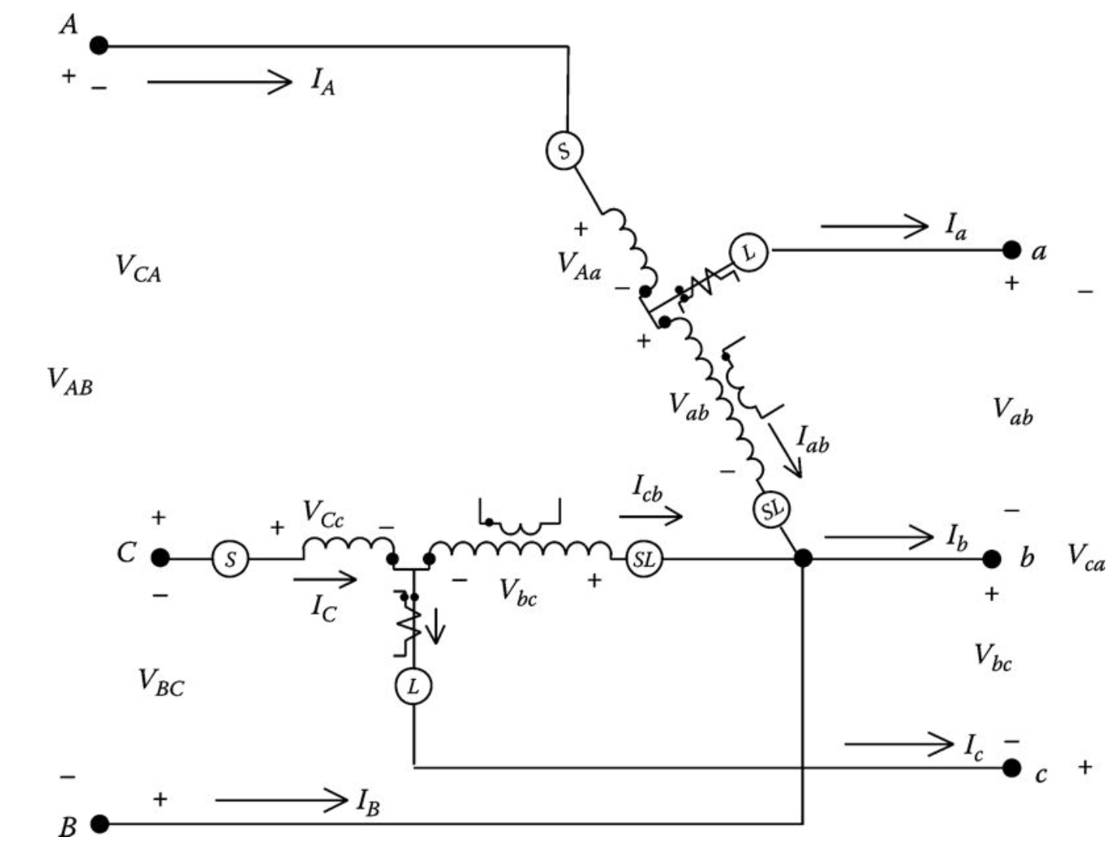
Module #3
Two Type B single-phase regulators can be connected in the open delta connection. Shown in below is an open delta connection where two single-phase regulators have been connected between phases AB and CB.

Slide 32
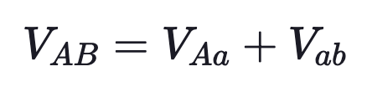
Open Delta-Connected Regulators
Module #3
Kirchhoff’s Voltage Law is first applied around a closed loop starting with the line-to-line voltage between phases A and B on the source side.

Slide 33
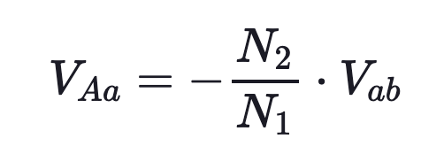
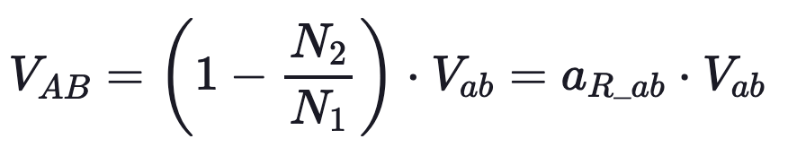
Open Delta-Connected Regulators
Module #3
We have
Substituting the above expression into the KVL equation

Slide 34
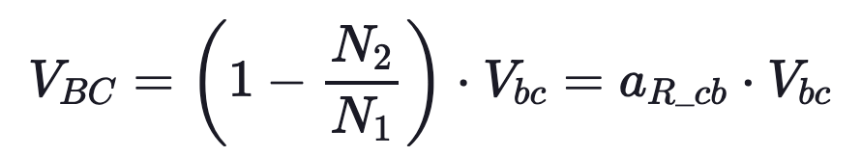
Open Delta-Connected Regulators
Module #3
We can follow the same procedure for the voltage across B and C

Slide 35
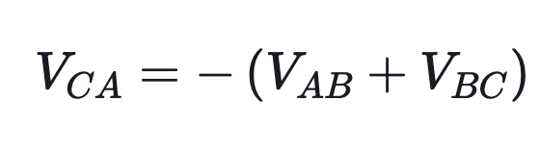
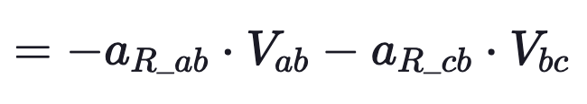
Open Delta-Connected Regulators
Module #3
Then using KVL

Slide 36
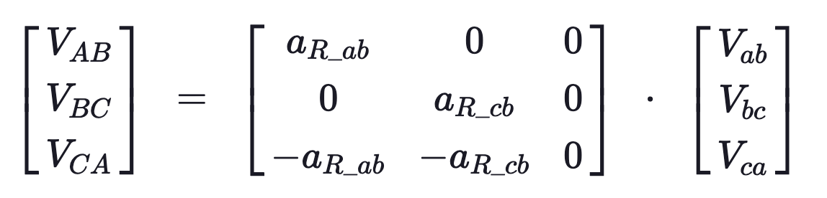
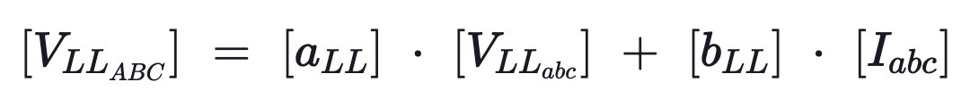
Open Delta-Connected Regulators
Module #3
Using all three equations we can form a matrix equation
which is of the form

Slide 37
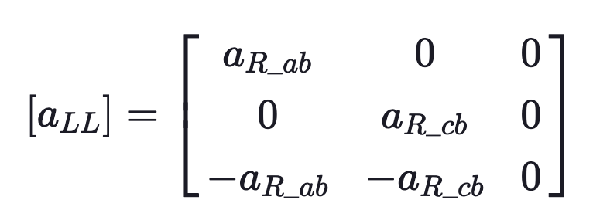
Open Delta-Connected Regulators
Module #3
Where we have
and [b_{LL}] is the zero matrix

